Slide 1
Essentials of
Systems Analysis and Design
Sixth Edition
Joseph S. Valacich
Joey F. George
Jeffrey A. Hoffer
Chapter 8
Designing the Human Interface
8.1

Slide 2
Learning Objectives
Explain the process of designing forms and reports and the deliverables for their creation
Apply the general guidelines for formatting forms and reports
Learn how to effectively format text, tables, and lists
Explain the process of designing interfaces and dialogues and the deliverables for their creation
8.2

Slide 3
Learning Objectives (continued)
Discuss the general guidelines for interface design including:
  Layout and design
  Structuring data-entry fields
  Providing feedback
  System help
8.3

Slide 4
Learning Objectives (continued)
Discuss the design of human-computer dialogues and the use of dialogue diagramming
Explain interface design guidelines unique to the design of Internet-based electronic commerce systems
8.4

Slide 5
Designing Forms and Reports
System inputs and outputs are produced at the end of the analysis phase
  Precise appearance is not necessarily defined during analysis phase
Forms and reports are integrally related to DFD and E-R diagrams
8.5

Slide 6
Designing Forms and Reports
Key Concepts
Form
  A business document that contains some predefined data and may include some areas where additional data are to be filled in
  An instance of a form is typically based on one database record
Report
  A business document that contains only predefined data
  A passive document for reading or viewing data
  Typically contains data from many database records or transactions
8.6

Slide 7
The Process of Designing Forms and Reports
User Focused Activity
Follows a Prototyping Approach
Requirements Determination:
  Who will use the form or report?
  What is the purpose of the form or report?
  When is the report needed or used?
  Where does the form or report need to be delivered and used?
  How many people need to use or view the form or report?
8.7

Slide 8
The Process of Designing Forms and Reports (continued)
Prototyping
  Initial prototype is designed from requirements
  Users review prototype design and either accept the design or request changes
  If changes are requested, the construction-evaluation-request cycle is repeated until the design is accepted
8.8

Slide 9
Deliverables and Outcome
Design specifications are major deliverables and contain three sections
  Narrative overview
  Sample design
  Testing and usability assessment
8.9

Slide 10
General Formatting Guidelines for Forms and Reports
Highlighting
  Use sparingly to draw user to or away from certain information
  Blinking and audible tones should only be used to highlight critical information requiring user’s immediate attention
  Methods should be consistently selected and used based upon level of importance of emphasized information
8.10

Slide 11
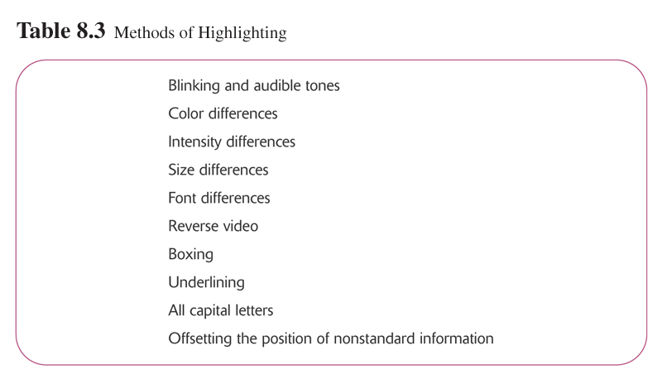
8.11

Slide 12
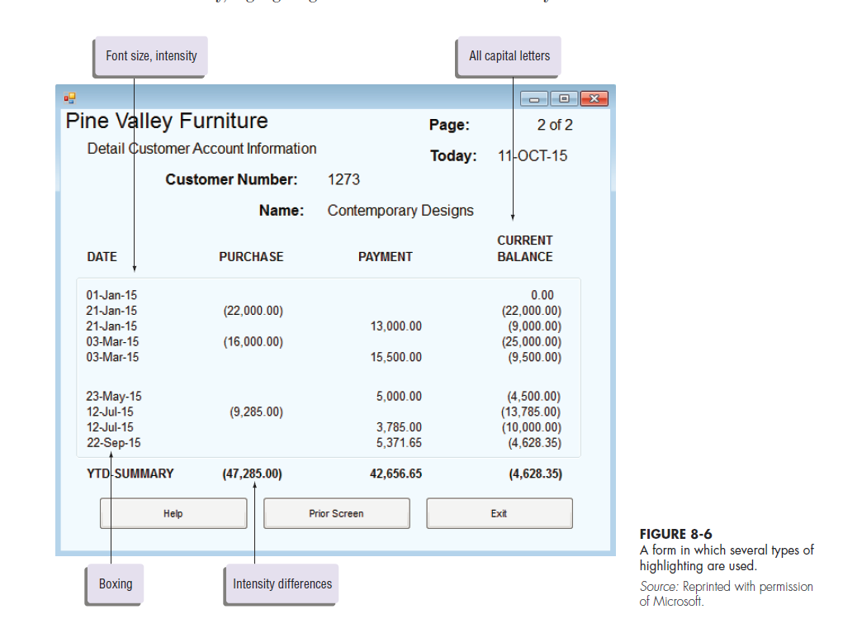
8.12

Slide 13
General Formatting Guidelines for Forms and Reports (continued)
Displaying Text
  Display text in mixed upper and lower case and use conventional punctuation
  Use double spacing if space permits. If not, place a blank line between paragraphs
  Left-justify text and leave a ragged right margin
  Do not hyphenate words between lines
  Use abbreviations and acronyms only when they are widely understood by users and are significantly shorter than the full text
8.13

Slide 14
General Formatting Guidelines for Forms and Reports (continued)
Displaying Tables and Lists
  Labels
    All columns and rows should have meaningful labels
    Labels should be separated from other information by using highlighting
    Redisplay labels when the data extend beyond a single screen or page
8.14

Slide 15
General Formatting Guidelines for Forms and Reports (continued)
Displaying Tables and Lists (continued)
  Formatting columns, rows, and text
    Sort in a meaningful order
    Place a blank line between every 5 rows in long columns
    Similar information displayed in multiple columns should be sorted vertically
    Columns should have at least two spaces between them
    Allow white space on printed reports for user to write notes
    Use a single typeface, except for emphasis
    Use same family of typefaces within and across displays and reports
    Avoid overly fancy fonts
8.15

Slide 16
General Formatting Guidelines for Forms and Reports (continued)
Displaying tables and lists (continued)
  Formatting numeric, textual, and alphanumeric data
    Right-justify numeric data and align columns by decimal points or other delimiter
    Left-justify textual data. Use short line length, usually 30 to 40 characters per line
    Break long sequences of alphanumeric data into small groups of three to four characters each
8.16

Slide 17
8.17

Slide 18
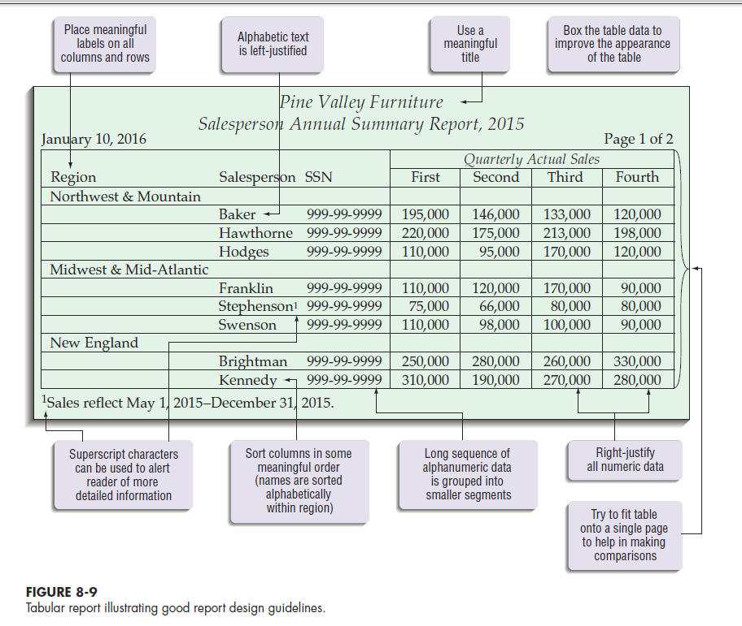
8.18

Slide 19
Designing Interfaces and Dialogues
Focus on how information is provided to and captured from users
Dialogues are analogous to a conversation between two people
A good human-computer interface provides a unifying structure for finding, viewing, and invoking the different components of a system
8.19

Slide 20
The Process of Designing Interfaces and Dialogues
User-focused Activity
Parallels Form and Report Design Process
Employs Prototyping Methodology
  Collect information
  Construct prototype
  Assess usability
  Make refinements
8.20

Slide 21
The Process of Designing Interfaces and Dialogues (continued)
Deliverables
  Design Specifications
    Narrative overview
    Sample design
    Testing and usability assessment
8.21

Slide 22
Designing Interfaces
Designing Layouts
  Standard formats similar to paper-based forms and reports should be used
  Screen navigation on data entry screens should be left-to-right, top-to-bottom as on paper forms
8.22

Slide 23
Designing Layouts
Flexibility and consistency are primary design goals
  Users should be able to move freely between fields
  Data should not be permanently saved until the user explicitly requests this
  Each key and command should be assigned to one function
8.23

Slide 24
Structuring Data Entry
Entry | Never require data that are already online or that can be computed
Defaults | Always provide default values when appropriate
Units | Make clear the type of data units requested for entry
Replacement | Use character replacement when appropriate
Captioning | Always place a caption adjacent to fields
Format | Provide formatting examples
Justify | Automatically justify data entries
Help | Provide context-sensitive help when appropriate
8.24

Slide 25
Controlling Data Input
One objective of interface design is to reduce data-entry errors
Role of systems analyst is to anticipate user errors and design features into the system’s interfaces to avoid, detect, and correct data-entry mistakes
Table 8-9 describes types of data entry errors
Table 8-10 lists techniques used by system designers to detect errors
8.25

Slide 26
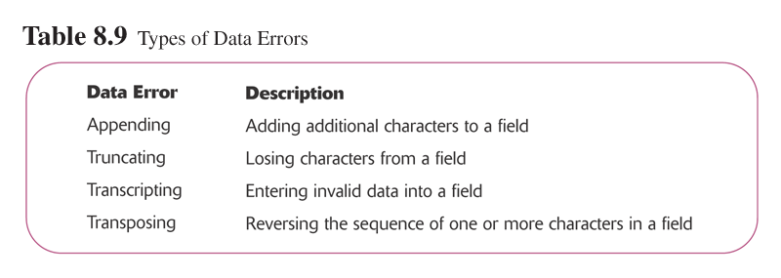
8.26

Slide 27
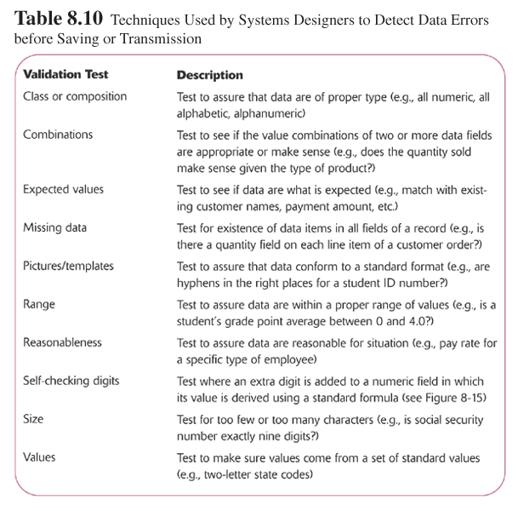
8.27

Slide 28
Providing Feedback
1. Status Information
  Keeps users informed of what is going on in system
  Displaying status information is especially important if the operation takes longer than a second or two
2. Prompting Cues
  Best to keep as specific as possible
3. Error and Warning Messages
  Messages should be specific and free of error codes and jargon
  User should be guided toward a result rather than scolded
  Use terms familiar to user
  Be consistent in format and placement of messages
8.28

Slide 29
Providing Help
Place yourself in user’s place when designing help
Guidelines
  Simplicity
    Help messages should be short and to the point
  Organization
    Information in help messages should be easily absorbed by users
  Show
    It is useful to explicitly provide examples to users on how to perform an operation
8.29

Slide 30
Providing Help (continued)
Context-Sensitive Help
  Enables user to get field-specific help
Users should always be returned to where they were when requesting help
8.30

Slide 31
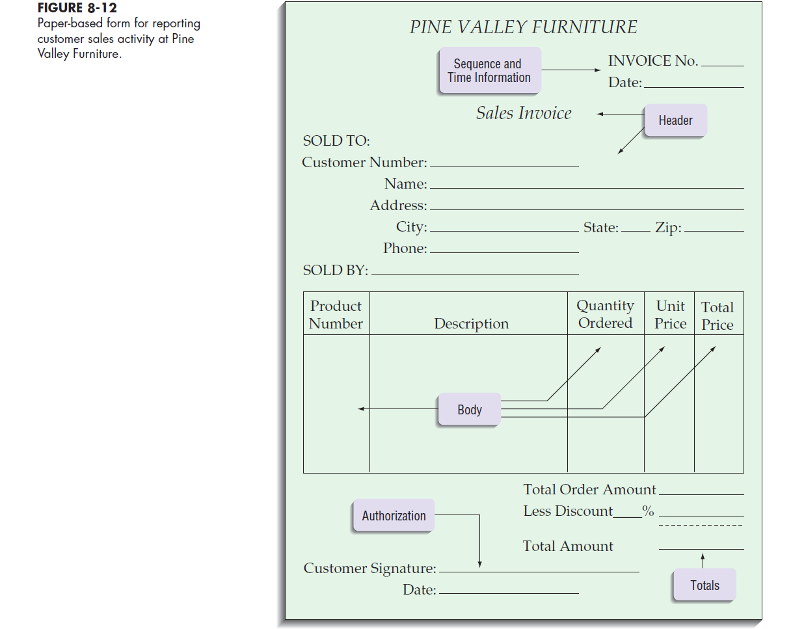
8.31

Slide 32
Designing Dialogues
Dialogue
  Sequence in which information is displayed to and obtained from a user
Primary design guideline is consistency in sequence of actions, keystrokes, and terminology
Three step process:
  1. Design the dialogue sequence
  2. Build a prototype
  3. Assess usability
8.32

Slide 33
Designing the Dialogue Sequence
Define the sequence
Have a clear understanding of the user, task, technological, and environmental characteristics
Dialogue Diagram
  A formal method for designing and representing human-computer dialogues using box and line diagrams
  Consists of a box with three sections
    Top: Unique display reference number used by other displays for referencing dialogue
    Middle: Contains the name or description of the display
    Bottom: Contains display reference numbers that can be accessed from the current display
8.33

Slide 34
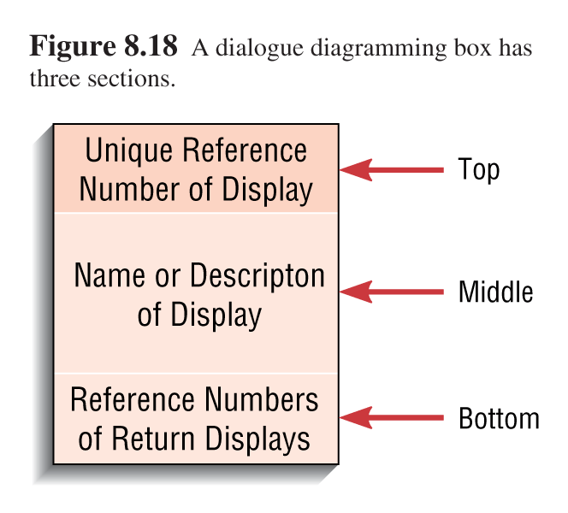
8.34

Slide 35
Designing Dialogues:
Building Prototypes and Assessing Usability
Activities often are optional
Task is simplified by using graphical design environment
8.35

Slide 36
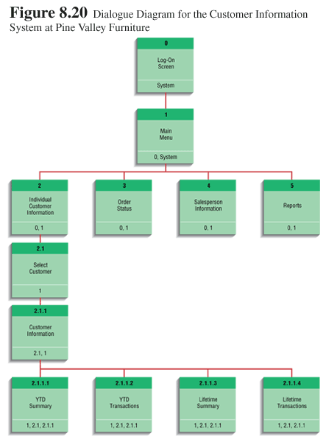
8.36

Slide 37
PVF WebStore:
Designing the Human Interface at Pine Valley Furniture
Design Guidelines
  Navigation via cookie crumbs
    A technique that uses a series of tabs on a Web page to show users where they are and where they have been in the site
    Tabs are hyperlinks to allow users to move backward easily within the site
    Two important purposes:
      Allows users to navigate to a point previously visited
      Shows users where they have been and how far they have gone from point of entry into site
8.37

Slide 38
Electronic Commerce Application:
Design Guidelines
Lightweight Graphics
  The use of small images to allow a Web page to be displayed more quickly
Forms and Data Integrity
  All forms that record information should be clearly labeled and provide room for input
  Clear examples of input should be provided to reduce data errors
  Site must clearly designate which fields are required, which are optional, and which have a range of values
8.38

Slide 39
Electronic Commerce Application:
Design Guidelines (continued)
Template-based HTML
  Templates to display and process common attributes of higher-level, more abstract items
  Creates an interface that is very easy to maintain
8.39

Slide 40
Summary
Designing Forms and Reports
General Guidelines for Designing Forms and Reports
Formatting Text, Tables, and Lists
Design Guidelines for Interfaces
  Layout design
  Structuring data-entry fields
  Providing feedback
  Designing help
8.40

Slide 41
Summary (continued)
Human-Computer Dialogue Design
Interface Design Guidelines Unique to the Internet
8.41

Slide 42

All rights reserved. No part of this publication may be reproduced, stored in a retrieval system, or transmitted, in any form or by any means, electronic, mechanical, photocopying, recording, or otherwise, without the prior written permission of the publisher. Printed in the United States of America.
Copyright © 2015 Pearson Education, Inc.
Publishing as Prentice Hall

